Slide 1
PGPDE Functional Programming in Python

Slide 2
Course overview
Objectives
To understand the syntax and semantics of Python
To apply the algorithms using python.
To build a practice of Functional Programming skills using Python
Outcome
Master the fundamentals of writing Python programs
Write Python functions to facilitate code reuse
Sessions: 20 sessions (1.5 Hours each)
Tools:
Jupyter Notebook
Google Colab

Slide 3
Topics planned for sessions 1 - 10
Introduction to Programming
Data Types, Categories, and Sources
Conditional Statements and Iterations
Iterations
Strings

Slide 4
What is Python?
Python is named after Monty Python and its famous flying circus, not the snake. It is a trademark of the Python Software Foundation.
Created by Guido Van Rossum in ‘89
Python is Interpreted − Python is processed at runtime by the interpreter. You do not need to compile your program before executing it. This is similar to PERL and PHP.
Python is Interactive − You can actually sit at a Python prompt and interact with the interpreter directly to write your programs.
Python is Object-Oriented − Python supports Object-Oriented style or technique of programming that encapsulates code within objects.
Python is a Beginner's Language − Python is a great language for the beginner-level programmers and supports the development of a wide range of applications from simple text processing to WWW browsers to games.
Additional reading:
www.python.org/doc/essays/blurb/
wiki.python.org/
https://www.python.org/about/
https://www.newgenapps.com/blog/r-vs-python-for-data-science-big-data-artificial-intelligence-ml

Slide 5
Installation
To Install Python:
Open an internet browser and go to https://anaconda.org/anaconda/python
From Anaconda, install Jupyter Notebook
From Anaconda we can also install other development environments like Spyder, Orange

Slide 6
Check your installation
Open Anaconda Prompt
Type and enter the following command
Jupyter Notebook
This should open up the application we require for all out exercises

Slide 7
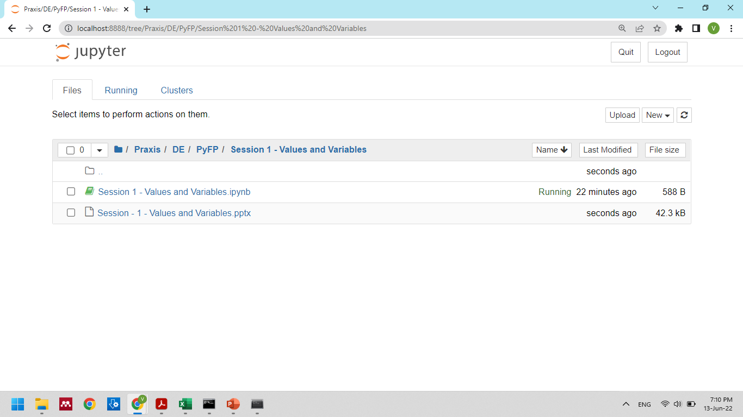
Create new notebook
current working directory
Files in the current working directory

Slide 8
Exploring jupyter notebook
New file
Save
Add cells, manipulate cells, delete
Change sequence of cells
Execute comment cells, simple calculations
Logout and shutdown terminal

Slide 9
Print text
Print a single text in a cell
Multiple texts in a cell
Use of special characters - \n, \t

Slide 10
Types of values
Python uses four types of values. This is also called constants or literals.
Integer int e.g. 1, 45, 101
floating point float e.g. 3.14, 9.8
String str e.g. “M”, “Y”, “hello world”
Boolean bool e.g. True, False

Slide 11
Variables
Variables always have names, and they store values
Variables are (also) of type integer, float, string, Boolean
Variables come into existence with their initial values

Slide 12
Rules for naming variables
A variable name must start with a letter or the underscore character.
_name, name
A variable name cannot start with a number.
2022sales X, sales2022
A variable name can only contain alpha-numeric characters and underscores (A-z, 0-9, and _ )
Variable names are case-sensitive (age, Age and AGE are three different variables)
Python keywords cannot be used as variable names

Slide 13
Quiz
Are these variables the same?
EmployeeName, employeename
Which of these are valid variable names?
_James_Bond_007
James_Bond_007
007_JamesBond
James_Bond_007!

Slide 14
PEMDAS
Order of operations follows this sequence
Parentheses Exponents Multiplication Division Addition Subtraction.

